Slide 1
Collect Input in Microsoft Teams with Task Modules

Slide 2

Overview
Task Module overview
Invoking task modules
Dismissing task modules

Slide 3
Microsoft Teams Task Modules

Slide 4
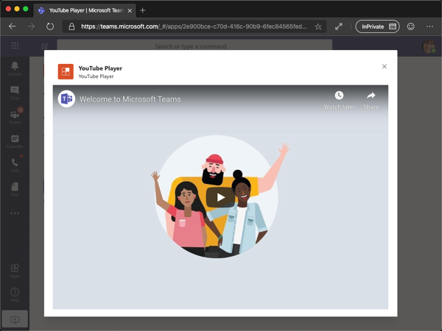
What is a task module?
Modal popup experience within Microsoft Teams
Ideal experience for collection input from a user
Can chain multiple together to create a wizard experience
Built on the foundation of Teams tabs – just a tab in a popup window
Can be implemented as a web page, or Adaptive Card
Notes:
Task modules allow you to create modal popup experiences in your Teams application. Inside the popup you can run your own custom HTML/JavaScript code, show an `<iframe>`-based widget such as a YouTube or Microsoft Stream video or display an Adaptive Card. They're especially useful for starting and completing tasks or displaying rich information like videos or Power BI dashboards. A popup experience is often more natural for users starting and completing tasks compared to a tab or a conversation-based bot experience.
Task modules build on the foundation of Microsoft Teams tabs; they're essentially a tab inside a popup window. They use the same SDK, so if you've built a tab you're already 90% of the way to being able to create a task module.
Task modules can be invoked in three ways:
Channel and/or personal tabs: Using the Microsoft Teams SDK, you can invoke task modules from buttons, links, or menus on your tab. Creating task modules for custom Microsoft Teams tabs is covered in this unit.
Bots: Buttons on cards sent from your bot can invoke task modules. This technique is useful when you don't need everyone in a channel to see what you are doing with a bot. For example, when having users respond to a poll in a channel it's not terribly useful to see a record of that poll being created. Creating task modules for bots is covered in another unit within this module.
Outside of Teams from a deep link: You can also create URLs to invoke a task module from anywhere using Microsoft Teams' support for deep links.

Slide 5
Task modules structure
App icon
App short name
Task module’s title
Close/cancel button
Entire area available to the web page option
Entire area rendered if using the Adaptive Card option
Adaptive Card button
Notes:
Let’s look at the basic parts of a task module and how they are rendered:
Your app's color icon.
Your app's short name.
The task module's title specified in the title property of the TaskInfo object.
The task module's close/cancel button. If the user presses this, your app will receive an err event as described here. (Note: It is currently not possible to detect this event when a task module is invoked from a bot.)
The blue rectangle is the where your web page appears if you are loading your own web page using the url property of the TaskInfo object. More detail is in the task module sizing section below.
If you are displaying an Adaptive card via the card property of the TaskInfo object the padding is added for you, otherwise you'll need to handle this yourself.
Adaptive card buttons will render here. If you're using your own page you must create your own buttons.

Slide 6
Invoking task modules
Can be invoked from tabs, bots, or deep links
Each invocation host is slightly different
Invoking from a tab:
Use the Microsoft Teams JavaScript SDK
Invoking from a deep link:
Special URL with task module details in the query string
Invoking from a bot:
Submit special invoke messages
Notes:
Task modules can be invoked from tabs, bots, or deep links and what appears in one can be either HTML or an Adaptive Card. This implementation provides many options in how they're invoked and how to deal with the result of a user's interaction.
Depending on where you are invoking the task module, the invocation is slightly different.
For tabs, use the Microsoft Teams JavaScript SDK.
For deep links, create a unique URL with the task module details on the query string.
For a bot, submit a special invoke message to the bot.

Slide 7
Developing Custom Microsoft Teams Task Modules
Notes:
In this section we will look at the development aspects to creating custom task modules.

Slide 8
Creating task modules as webpages
Task modules can be implemented as a web page
Similar to custom tabs: displayed within an IFRAME
Users can close the task module with the traditional “X” in the upper corner of the IFRAME
Programmatically close / submit the task module using the JavaScript SDK:
microsoftTeams.tasks.submitTask(returnValue);
Notes:
Task modules are similar to tabs in that they can be implemented as web pages.
The task module’s web page is displayed within an IFRAME when it is invoked.
The user can dismiss the task module in one of two ways:
They can select the traditional window close “X” in the upper corner of t he IFRAME
OR they can select a button or link that uses the JavaScript SDK to call the submitTask() method that will close the task module

Slide 9
Invoking task modules from tabs
Create a TaskModuleTaskInfo object
Specify the details of the task module
Include callback that receives errors or response from task module
Open the task module with the Microsoft Teams JavaScript SDK
microsoftTeams.tasks.startTask(taskModuleTaskInfo, callback);
TaskModuleTaskInfo properties:
Properties | Description
title | Appears below the app name and to the right of the app icon
height & width | Number in pixels for the size of task module, or named sizes (small/medium/large)
url | URL of the page loaded as an IFRAME inside the task module (not applicable for Adaptive Cards)
fallbackUrl | If a client doesn't support the task module feature, this URL is opened in a browser tab.
Notes:
Let’s look at invoking a task module from a tab. This is done by calling the startTask() method in the Microsoft Teams JavaScript SDK. This method accepts two parameters.
The first parameter is an instance of the TaskModuleTaskInfo object that contains properties that define the size and contents of the task module. In the case of a task module implemented using a web page, the URL property is set to the location of the page to load in the task module. You can also create task modules with adaptive cards… this is covered in the next section.
Additional properties on the TaskModuleTaskInfo object are as follows:
`title` (string): Appears below the app name and to the right of the app icon.
`height` & `width` (number | string): These properties can be a number representing the task module's dimensions, or one of the predefined sizes (small, medium, or large). The named sizes are predefined percentages of the available space to display the task module. For the width, they're 20%, 50% & 60% while the height values are 20%, 50%, and 66%.
`url` (string): The URL of the page loaded as an `<iframe>` inside the task module. The URL's domain must be in the app's `validDomains` array in your app's manifest. - (not applicable for Adaptive Cards)
`failbackUrl` (string): If a client doesn't support the task module feature, this URL is opened in a browser tab.

Slide 10
Task module callbacks
When invoking a task module with startTask(), can specify a submitHandler callback
submitHandler(error: string, result: string | any)
Callback receives the result as either a string (from a webpage) or object (webpage / Adaptive Card)
If there was problem invoking the task module, returned as string in error parameter:
Values for both card and url were specified. One or the other, but not both, are allowed
You must specify a value for either card or url
Invalid appId
User cancelled/closed the task module
Notes:
The second parameter on the startTask() method is a callback. This contains two parameters: an error string and a result.
The `result` can be either a string or an object.
The callback is executed when there is either an error invoking the task module or when the task module submits a value back to the tab. In the case of a web page, this is done using the submitTask(result) method in the JavaScript SDK.
If an error object is passed to the callback, it will be one of the following values:
"Values for both card and url were specified. One or the other, but not both, are allowed.": The `taskInfo` object contains values for both the `url` and `card` property. *These are mutually exclusive and only one should be specified.*
"You must specify a value for either card or url.": This error is the inverse of the previous one. Either the `url` or `card` properties are required.
"Invalid appId.": The `taskInfo.appId` property is not valid.
"User cancelled/closed the task module.": The user closed the task module.

Slide 11
Demo

Slide 12
Thank you.

